Slide 1
CST8285 ASSIGNEMT 2 DEMO
BookSpace – a Book Cataloging System
Presented by Group 9, Section 311
Group Members:
Cheng Qian
Ha Nhu Y Tran

Slide 2
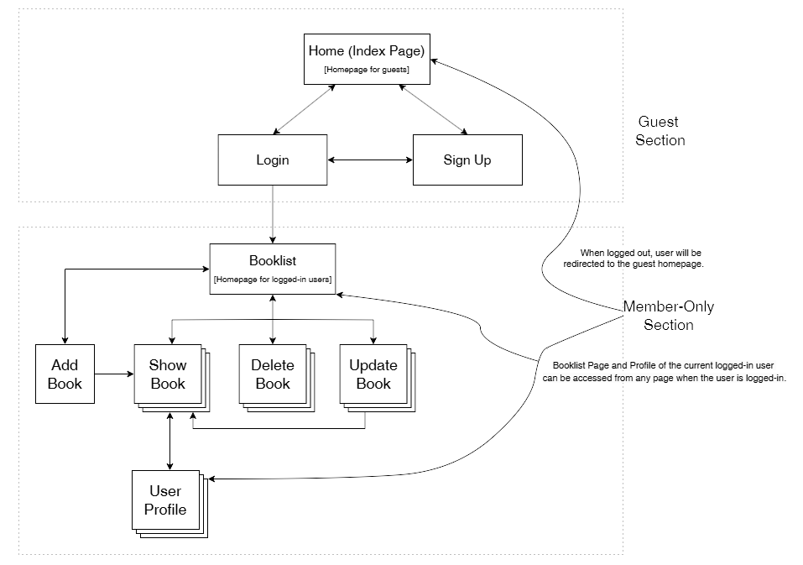
BOOKSPACE
Site Map

Slide 3
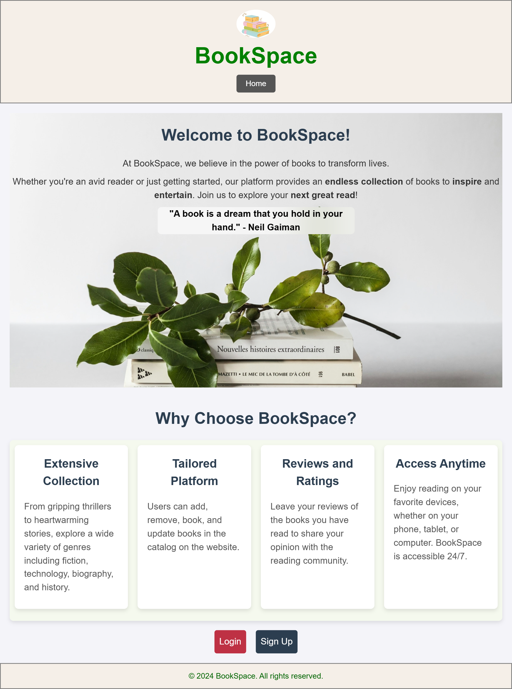
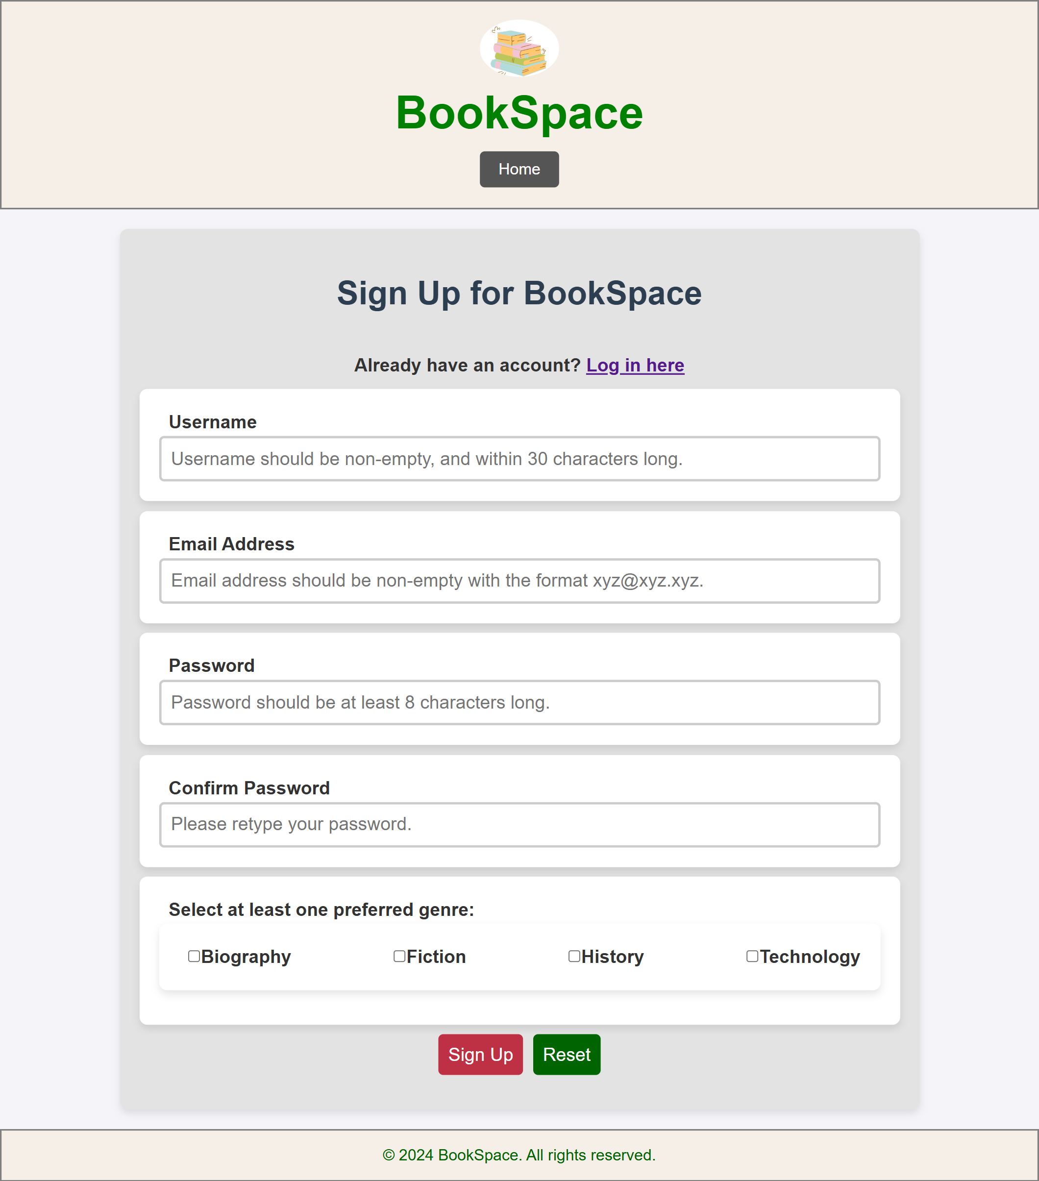
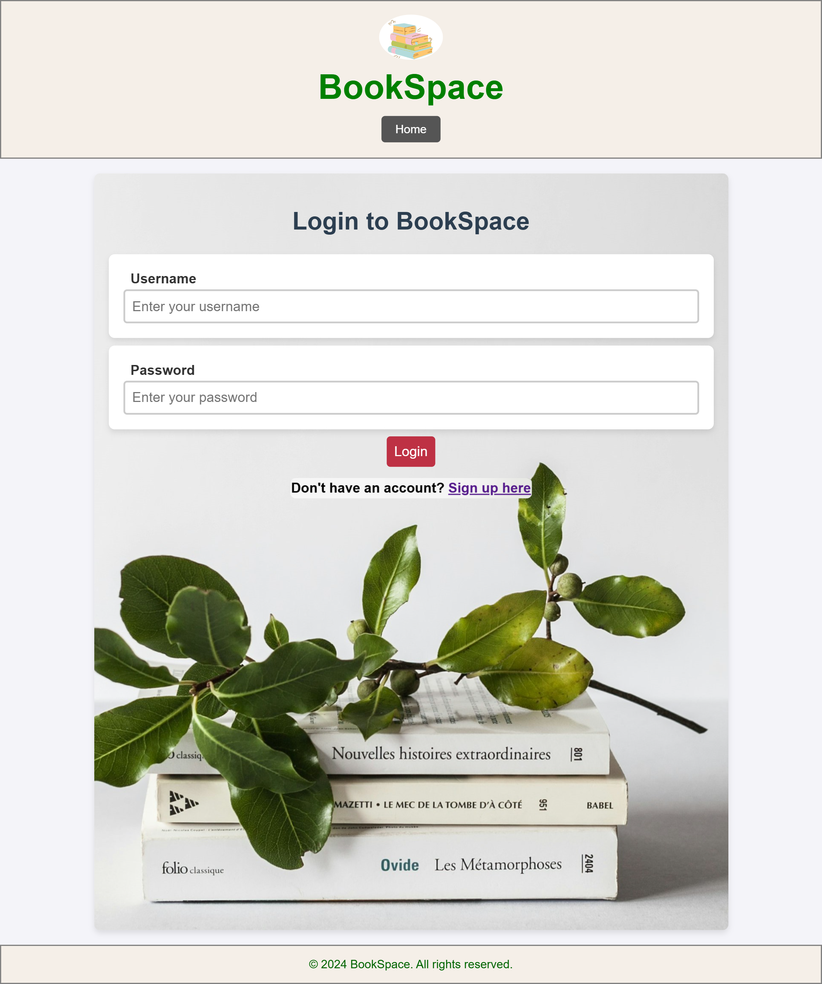
BOOKSPACE
Guest Section

Slide 4
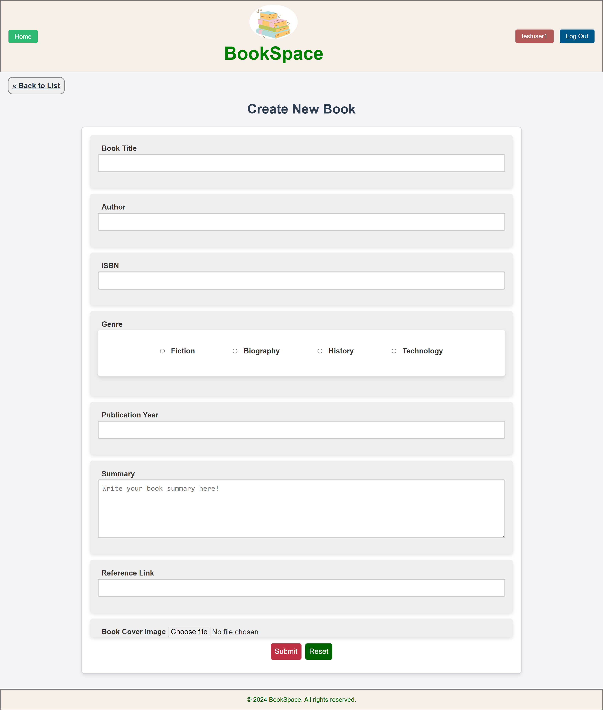
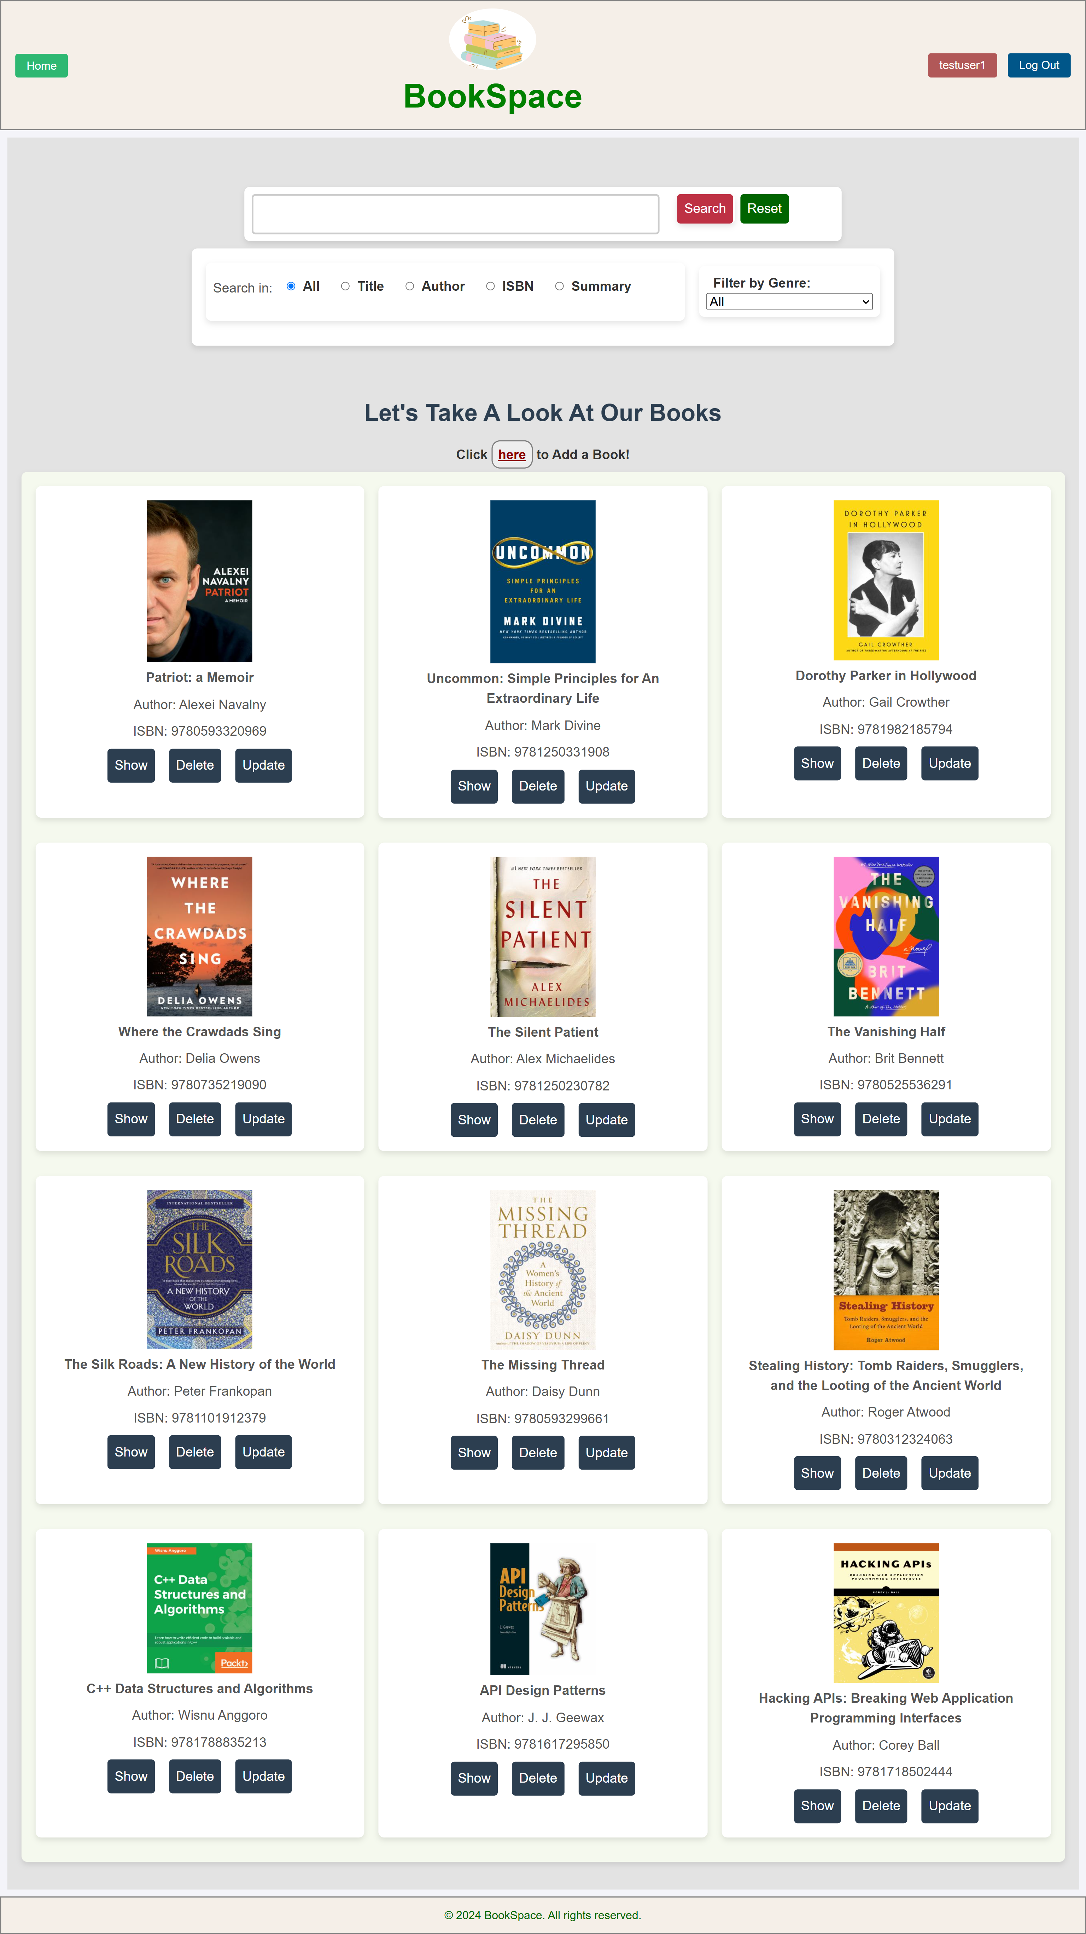
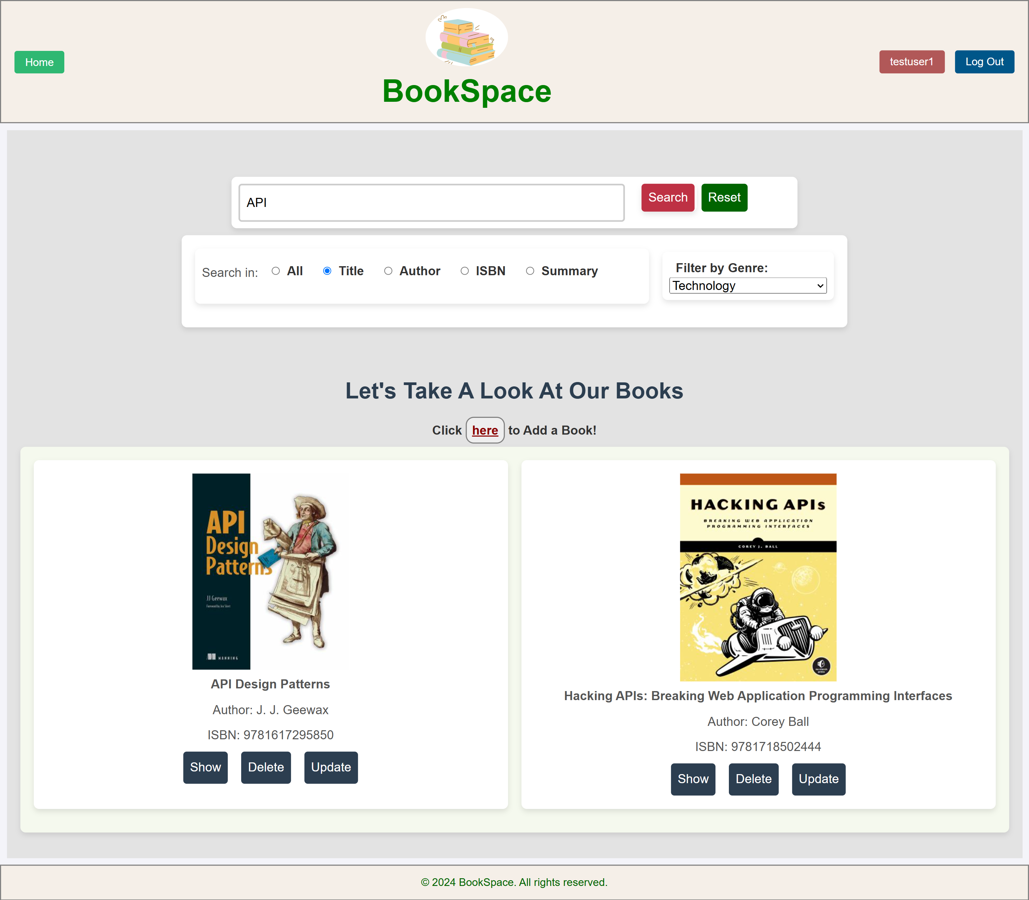
BOOKSPACE
Find the book you want, or add something new

Slide 5
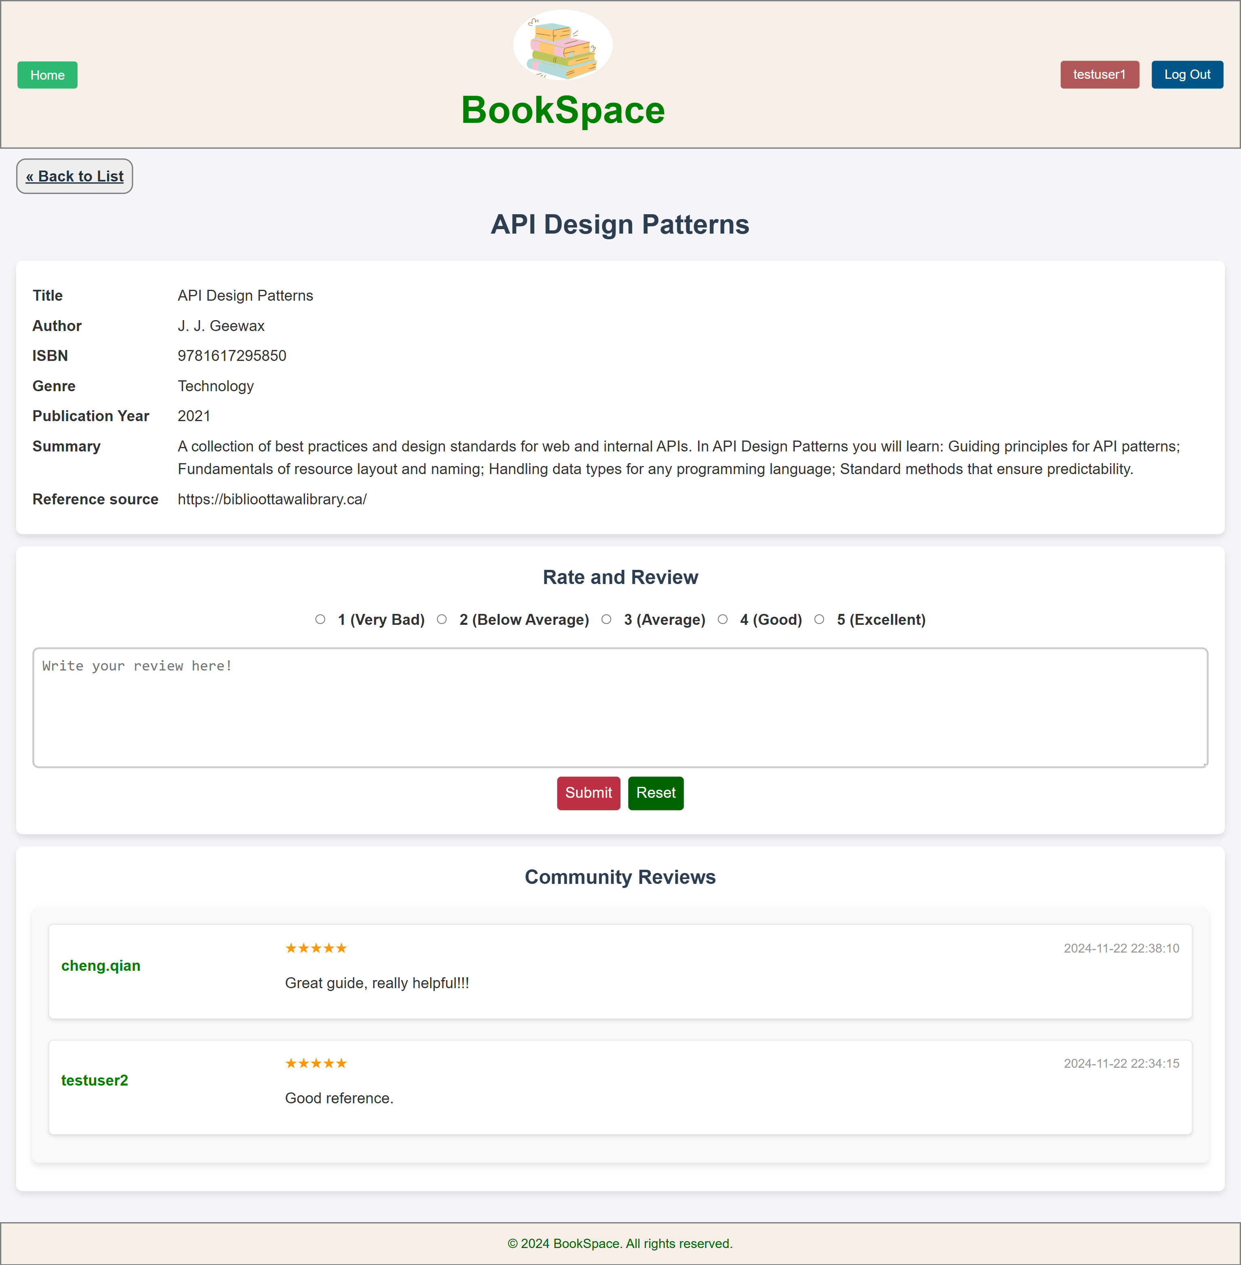
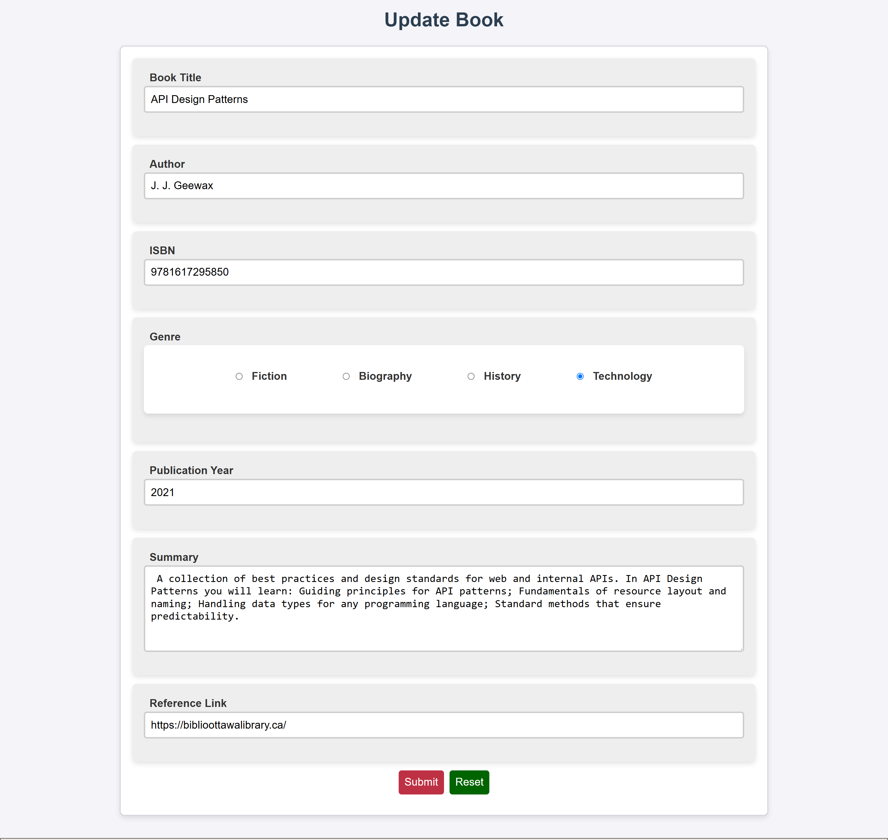
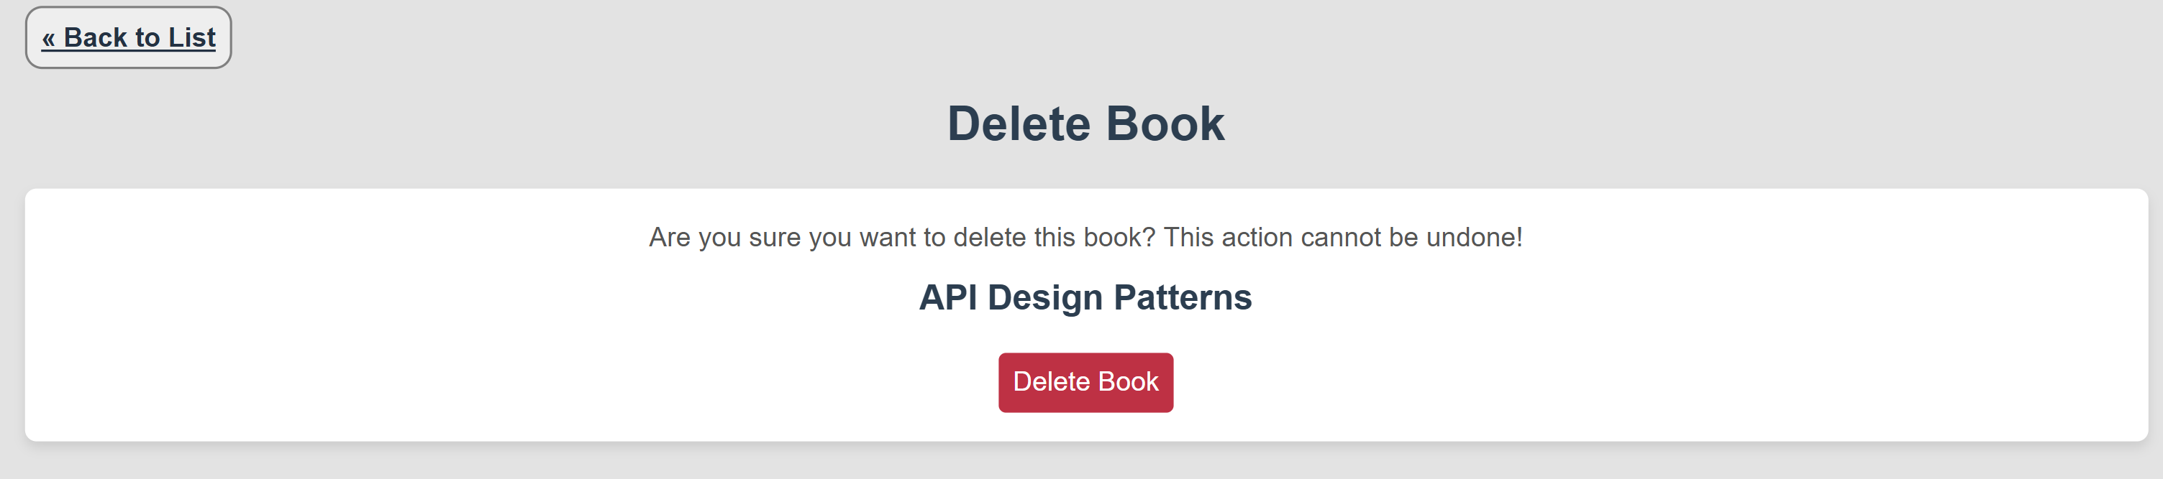
BOOKSPACE
Show, Update and Delete Books

Slide 6
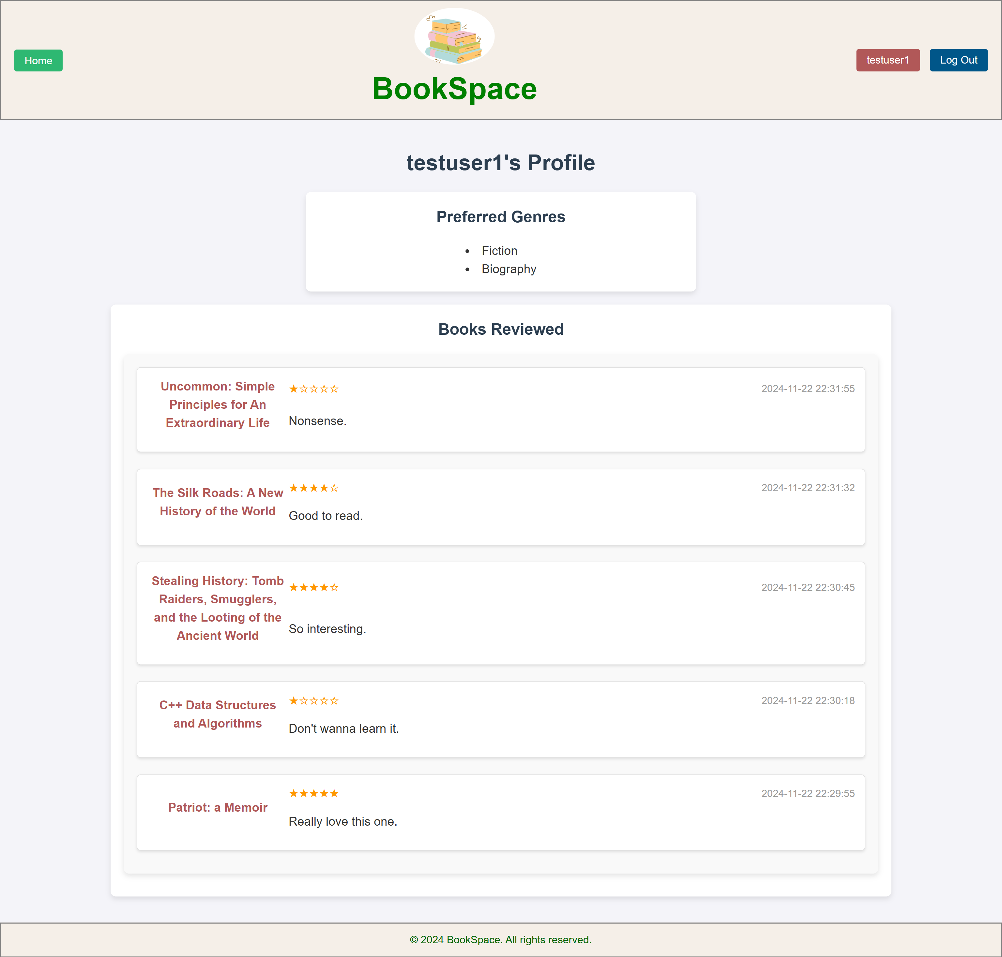
BOOKSPACE
Check A User’s Profile

Slide 7
BOOKSPACE
THANK YOU!

